Slide 1
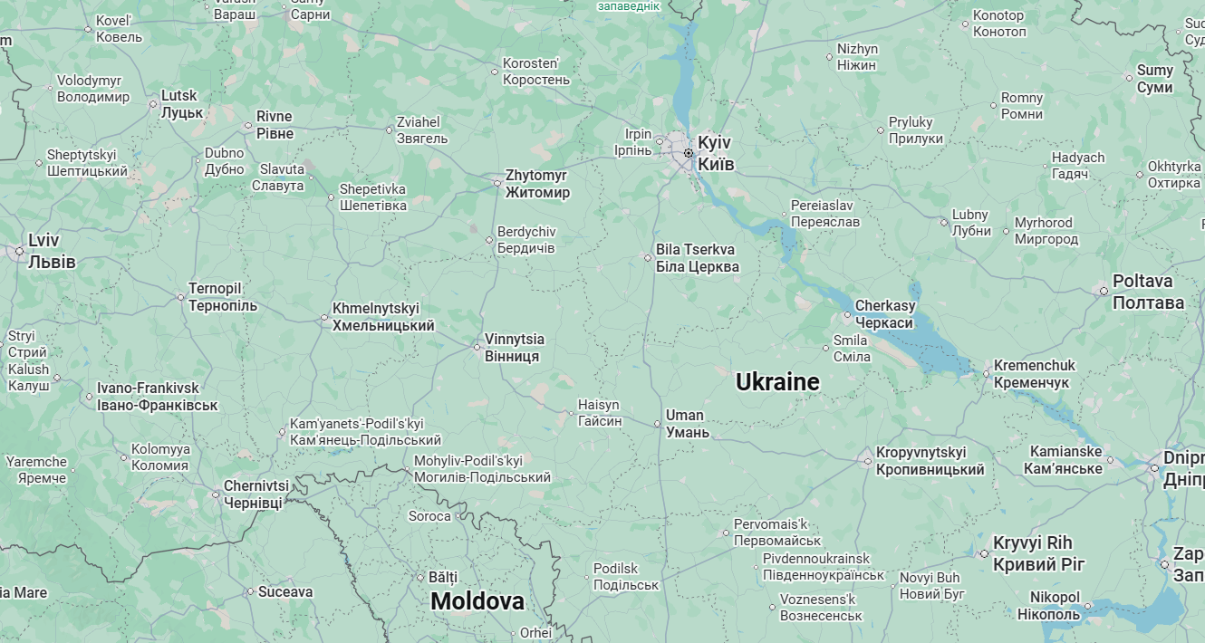
“Milestones” for AGS Frontier-Uman empirical box
Line a
6A
Line b
Line d
III PzKo
PzGp1(-)
17A
Line e
Proskurov
Proskurov
Line c
Kirovograd
(11A)
Original “small
pocket” COA

